Slide 1


PEOPLE'S COMMITTEE OF BINH CHANH DISTRICT
TAN NHUT 6 primary school
to
Ms Trâm’s lesson

Slide 2
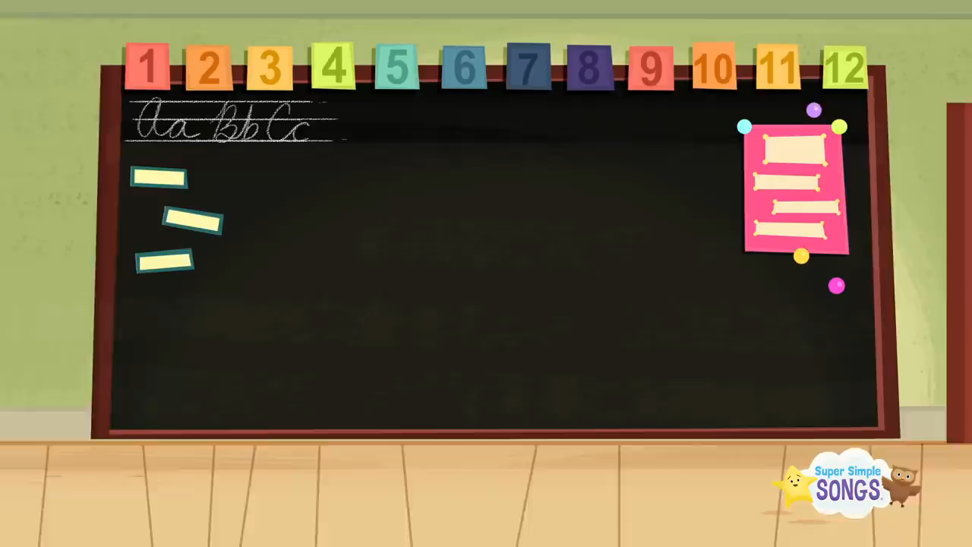


Slide 3


Slide 4
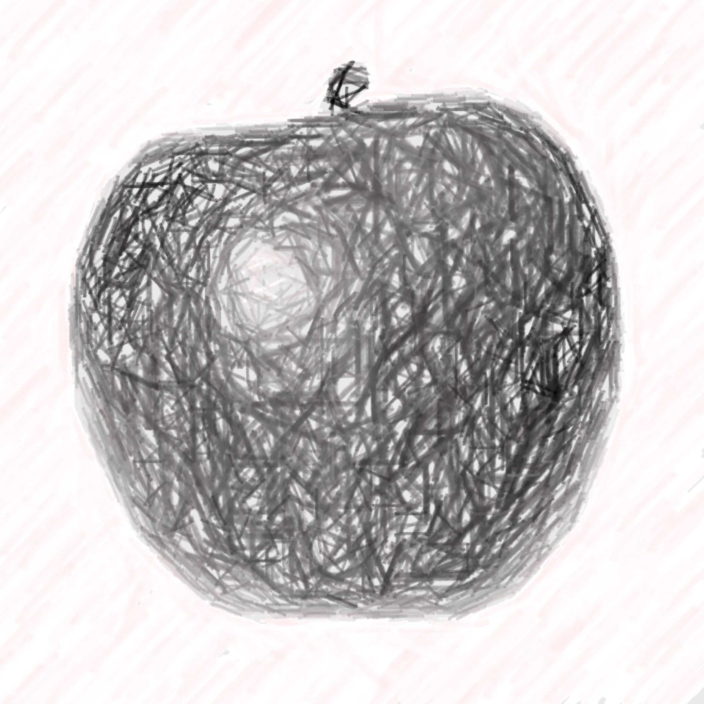
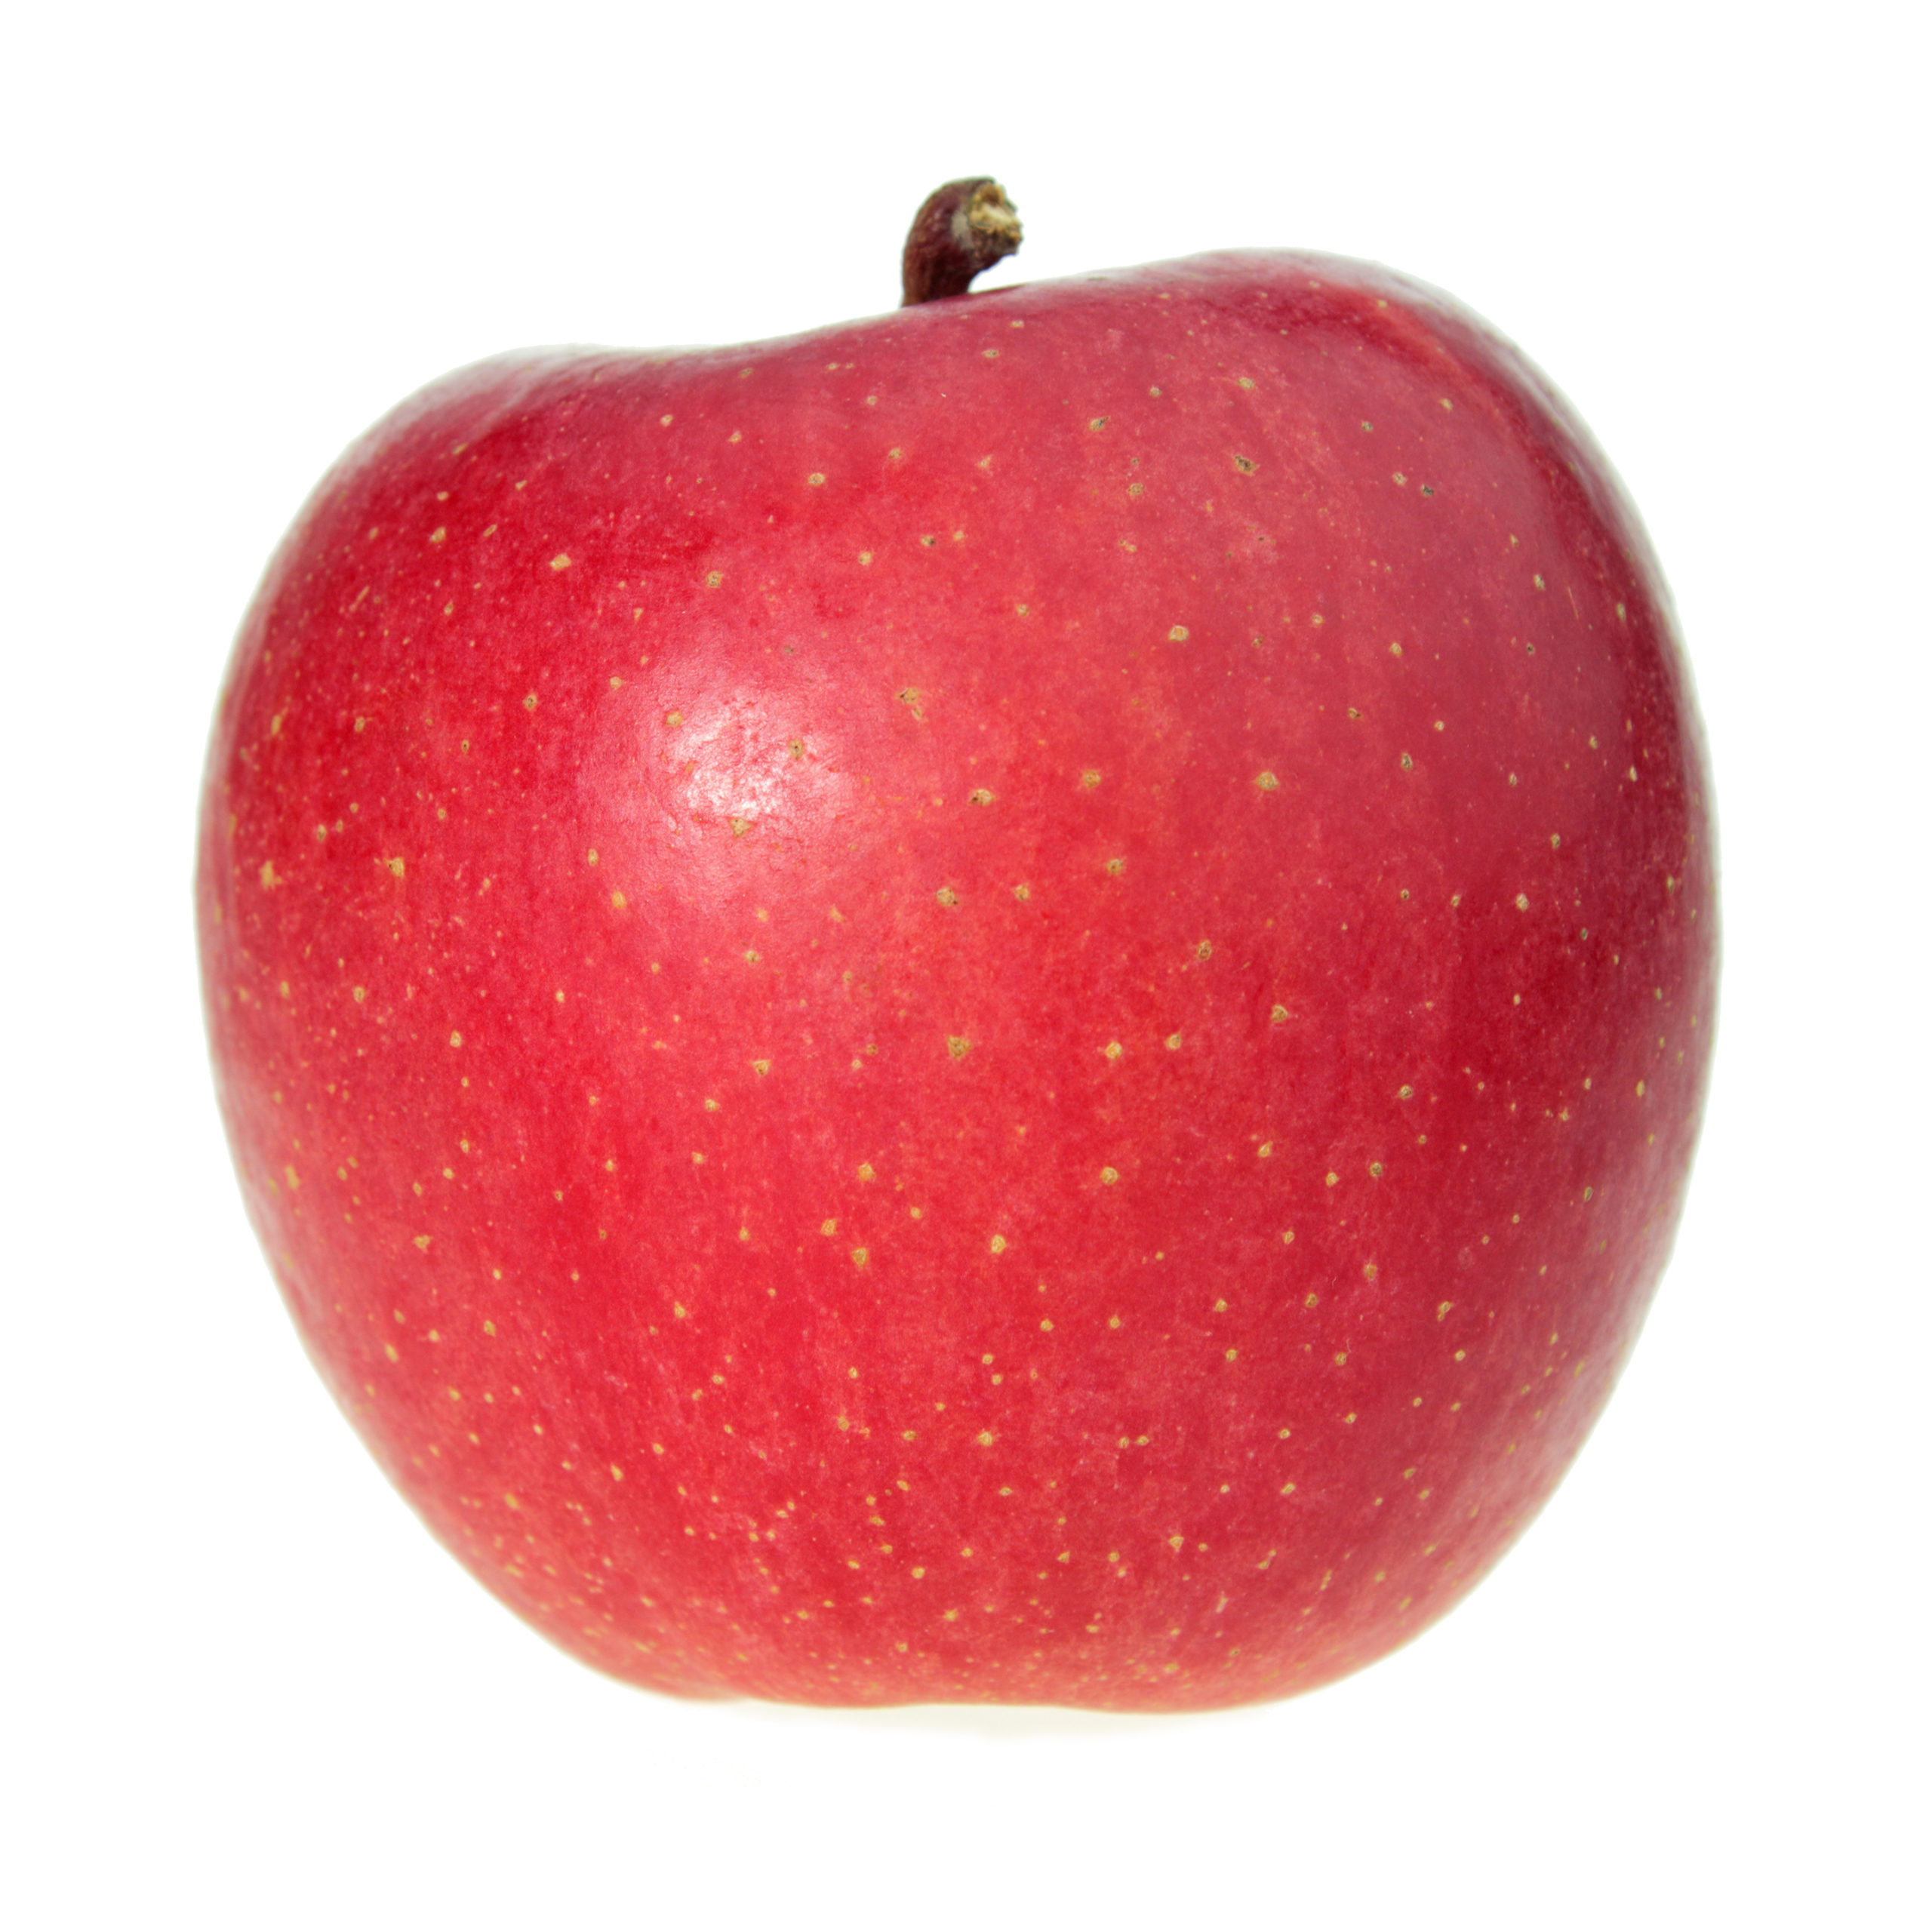





Choose the correct color.

Slide 5



Choose the correct color.

Slide 6
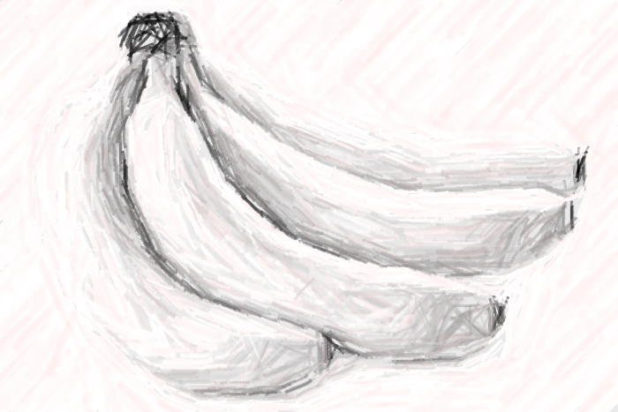
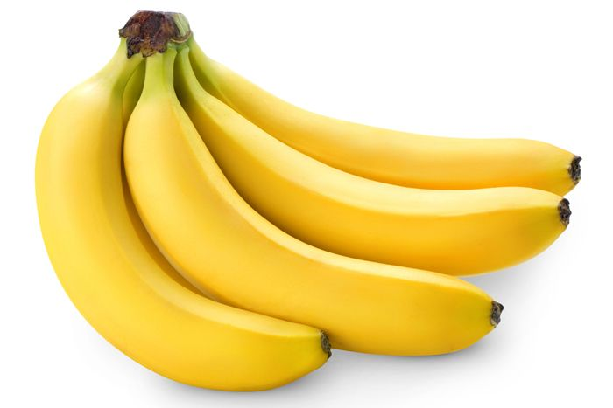

Choose the correct color.

Slide 7



Choose the correct color.

Slide 8
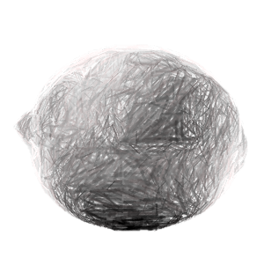

Choose the correct color.

Slide 9
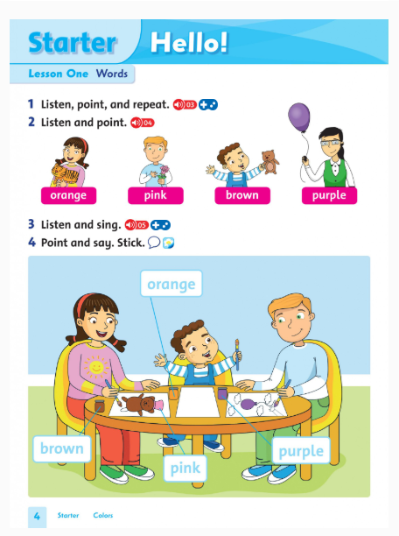
Unit Starter
Hello!
Lesson 1 Words
Page 4

Slide 10

1 Listen and repeat.

Slide 11

orange
Ms Trâm

Slide 12

pink
Ms Trâm

Slide 13

brown
Ms Trâm

Slide 14

purple
Ms Trâm

Slide 15

2 Listen and point.
Ms Trâm

Slide 16





Ms Trâm

Slide 17
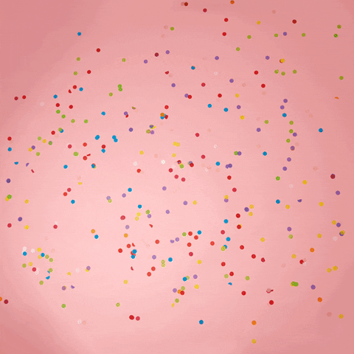
It’s play time!

Slide 18
Orange
1
2
3
4
Pink
brown
purple
5
6
7
8
Notes:
MEMORY GAME

Slide 19

3 Listen and sing.
Ms Trâm

Slide 20



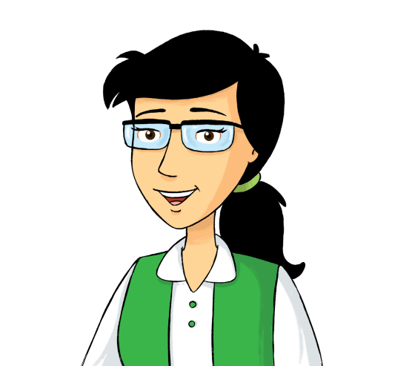
Hello, everyone.
Ms Trâm

Slide 21
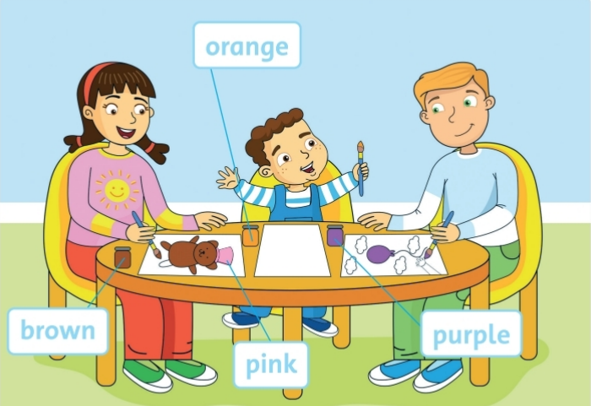
3 Point and say. Stick.
orange
brown
pink
purple
4 minutes.

Slide 22
brown
purple
orange
pink
Ms Trâm

Slide 23


Slide 24


Slide 25



BiTa English

